Slide 1

School of Computer Science and Engineering
Heart Disease Risk prediction using Survival Modelling and Transformer
M KARTHIK 22BCE9804
M BALAJI ANUDEEP 22BCE9438
K RAM TRINADH 22BCE20368
P ASHOK 22BCE20005

Slide 2
Outline
Abstract
Introduction
Problem Statement
Objectives
Dataset Details
Software Requirements
Project Work Flow
Explanation
Streamlit Web Application
Results
Conclusion

Slide 3
Abstract
This project predicts heart disease risk using the Framingham Heart Study dataset.
A hybrid framework combining survival analysis and Deep learning models is used to capture both time-dependent and non-linear relationships.
Models include Cox Proportional Hazards, DeepSurv, FT-Transformer, and SHAP for explainability.
An interactive Streamlit web application was developed for real-time prediction and interpretation.

Slide 4
Introduction
Heart disease is one of the leading causes of mortality worldwide, emphasizing the need for accurate risk prediction systems.
Traditional methods rely on fixed risk charts and linear assumptions that fail to generalize well to diverse populations.
This project leverages advanced survival modeling and transformer architectures for more accurate, interpretable, and accessible predictions.

Slide 5
Problem Statement
Manual clinical assessments are subjective and lack precision for long-term heart disease prediction.
Traditional models like logistic regression fail to capture non-linear and time-dependent relationships among variables.
There is a lack of integrated survival and deep learning-based approaches for cardiovascular prediction tasks.
Current methods often trade off interpretability for accuracy, creating barriers in clinical adoption.
This project addresses these limitations by developing a transparent, hybrid prediction system with explainable outputs.

Slide 6
Objectives
To develop a predictive framework for estimating heart disease risk using survival modeling and deep learning.
To compare and analyze the performance of Cox, DeepSurv, and FT-Transformer models.
To evaluate interpretability using SHAP for feature importance analysis.
To preprocess and balance the Framingham dataset for optimal model training.
To assess models using accuracy, concordance index, and AUC metrics.
To deploy an end-to-end interactive Streamlit application for public use and visualization.

Slide 7
Dataset Details
Dataset: Framingham Heart Study — a longitudinal study tracking cardiovascular risk factors.
Samples: 4,000+ records with 15 clinical and lifestyle variables.
Features include: Gender, age, education, currentSmoker, cigsPerDay, BPMeds, prevalentStroke, prevalentHyp, diabetes, totCho,l sysBP, diaBP, BMI, heartrate, glucose, TenYearCHD .
Target: TenYearCHD (binary variable indicating heart disease occurrence within 10 years).
Preprocessing involved imputing missing data, scaling features, and addressing class imbalance.

Slide 8
Software requirements
Software Requirements Language : Python 3.8+
Frameworks : PyTorch
Libraries : Scikit-Learn, NumPy, Pandas, Matplotlib / Seaborn, SHAP, Lifelines, Joblib
Tools : Google Colab

Slide 9
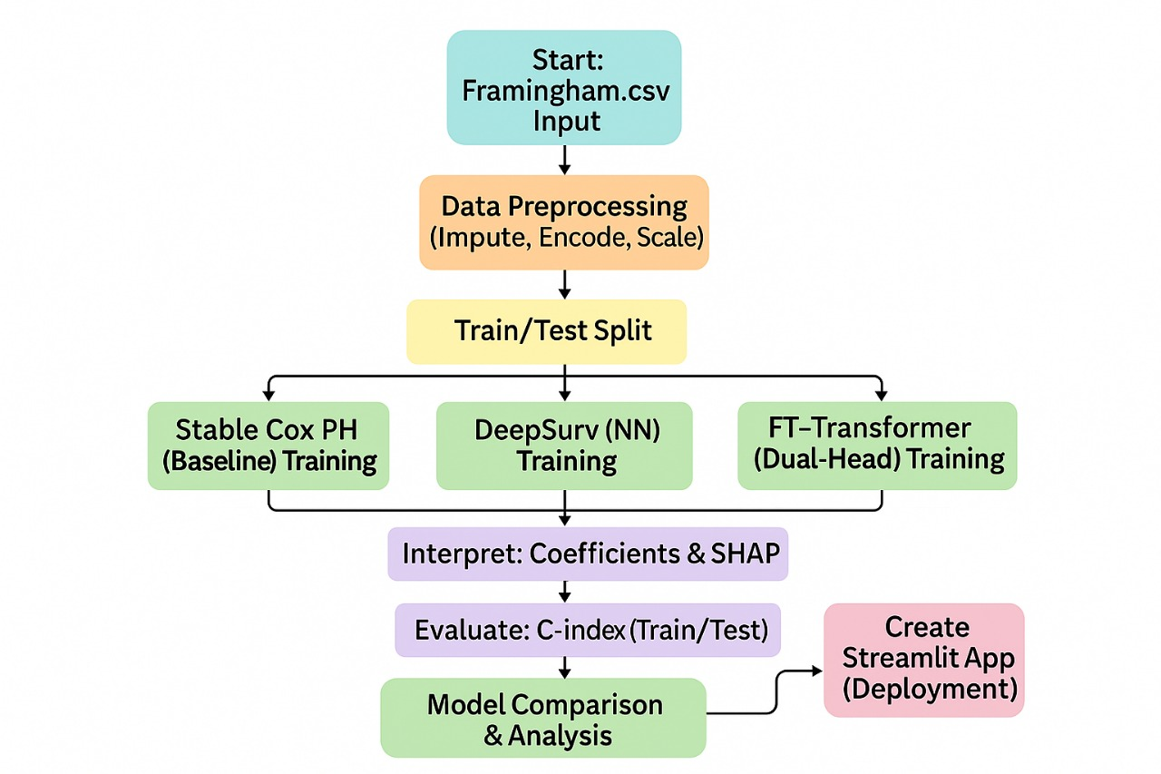
Project Workflow

Slide 10
Model Evaluation :
  Performance evaluation is done using both survival and classification metrics. The Concordance Index (C-index) measures how well predicted risks align with actual survival times ,a higher C-index indicates better predictive performance.
  Additionally, metrics such as accuracy are calculated for the classification head. Loss curves and C index graphs are analyzed to assess training stability and predictive performance.
Model Explainability (SHAP) :
  To ensure interpretability, the project employs SHAP (Shapley Additives Explanations) to visualize and explain the contribution of each feature to the final prediction.
  SHAP values identify which features most influence a patient’s heart disease risk typically age, cholesterol, and systolic blood pressure. This enhances transparency of FT Transformer model and helps clinicians trust and understand the model’s decisions.

Slide 11
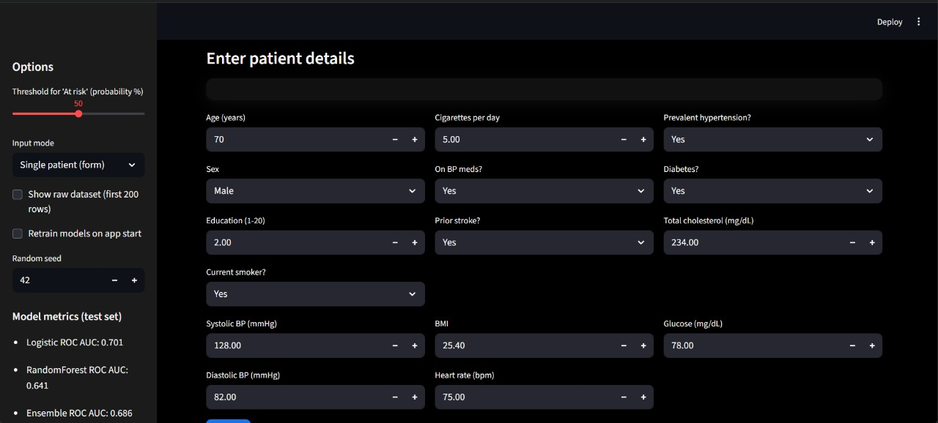
Web Application Implementation

Slide 12
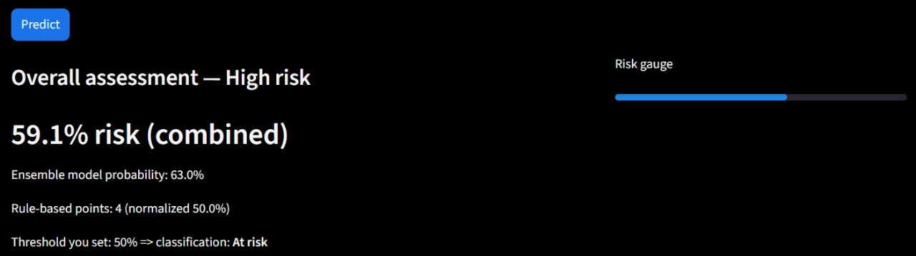
Web Application Implementation

Slide 13
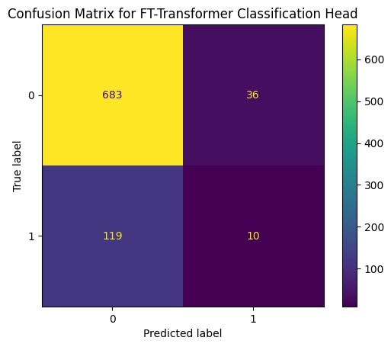
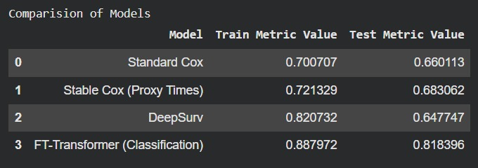
Results
Comparision of Models
Confusion matrix for FT-Transformaer

Slide 14
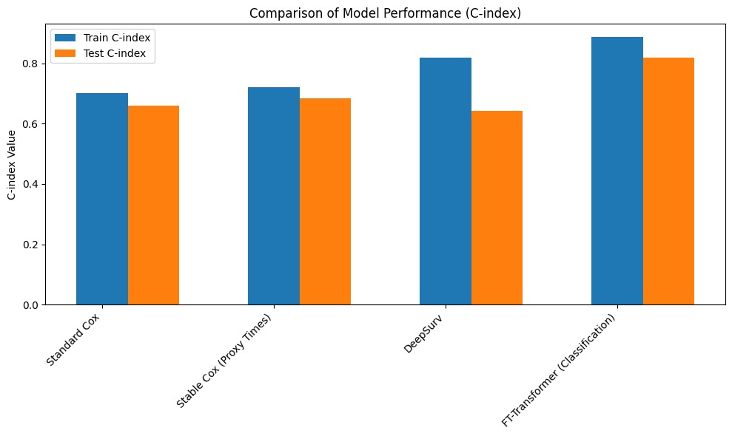

Slide 15
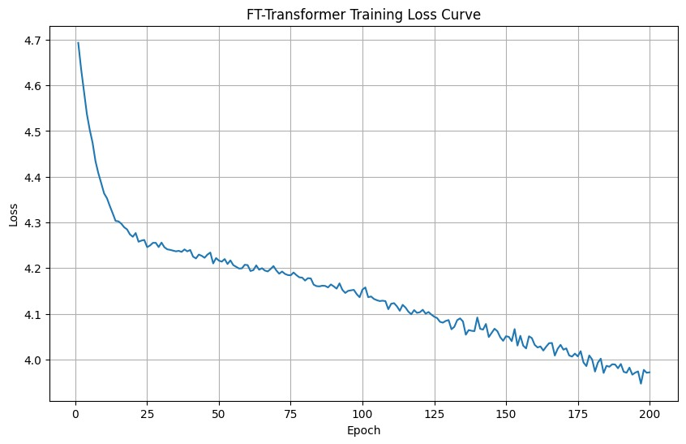
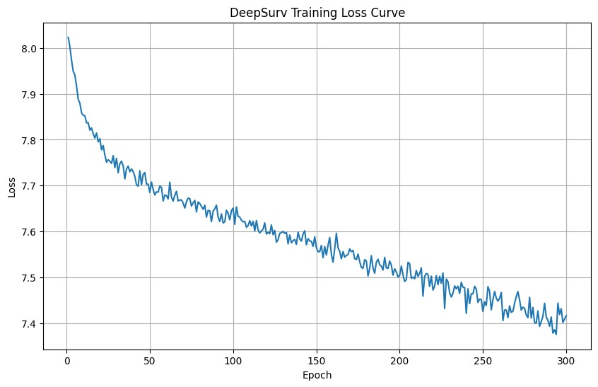
Results
Ft Transformer Training Loss Curve
Deepsurv Training Loss Curve
The FT-Transformer converged faster and more smoothly, showing efficient learning and stable optimization within 200 epochs, while DeepSurv learned more gradually with minor fluctuations, indicating slower but steady convergence. Overall, the FT-Transformer trained more efficiently, whereas DeepSurv showed consistent yet slower adaptation

Slide 16
Conclusion
Integrating classical survival analysis with deep learning improves both accuracy and interpretability of heart disease risk prediction.
The web app converts model insights into a practical tool for early diagnosis and prevention.
FT-Transformer achieved the highest C-index, showing superior accuracy, stability, and interpretability for long-term CHD risk prediction.

Slide 17
Thank You

